Slide 1

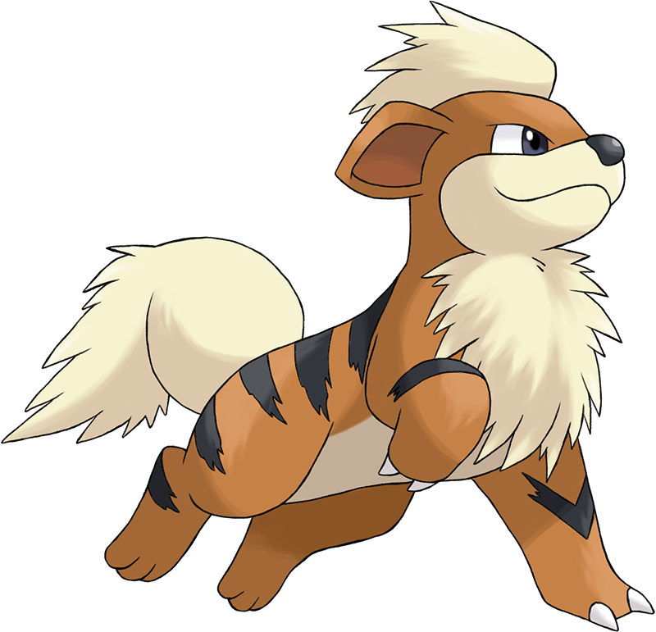
Catch these Poké-Hands
Ian Arch, Paige Breyfogle, Daniel Buescher, Andrew Stepanek

Slide 2
Previously On “Pokémon: Gotta graph em all!”
Created empty DataFrame of Gen1 Pokemon with Stats
Retrieved name and stats from pokeapi.co
Created SQL Database
Connected Flask routes to our database
Created routes for each Type of Pokemon
Used HTML, CSS, JavaScript, and D3 to display on a web page

Slide 3
Gameplan
Primary Goal: Expand on our prior project and leverage Machine Learning to predict the winner of a fight between two selected Pokemon
Secondary Goal: Utilize Machine Learning to predict a Pokémon’s type based on stats
“Everyone has a plan, until they get punched in the mouth”- Iron Mike Tyson
These are the snags/problems that we encountered along the way…

Slide 4
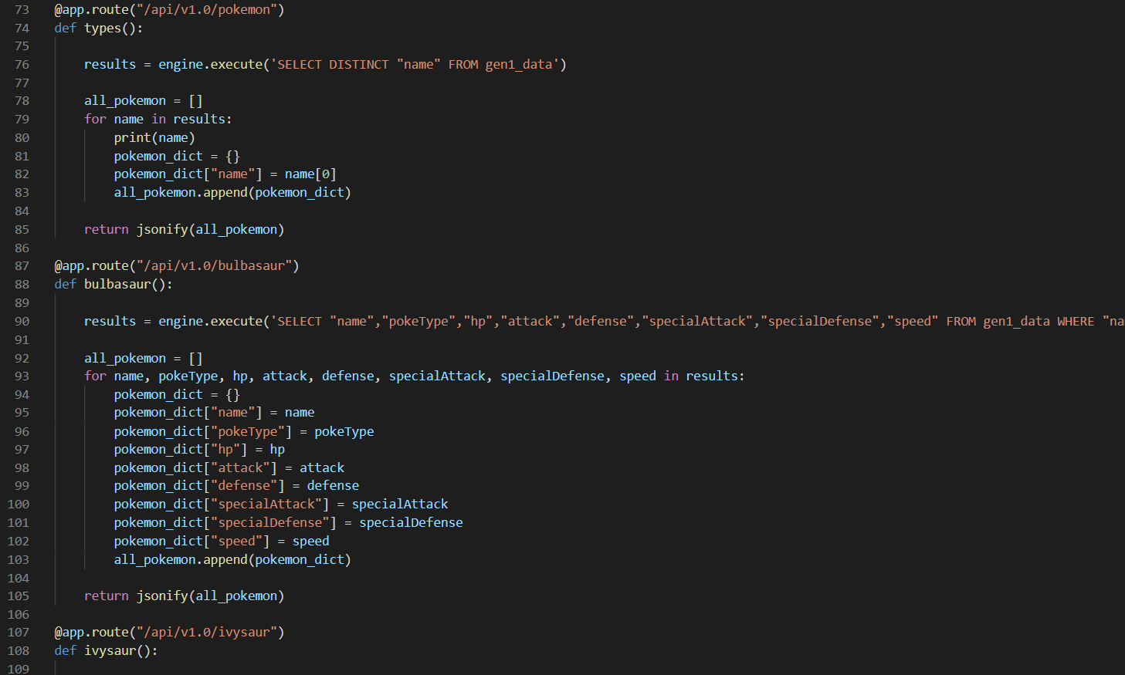
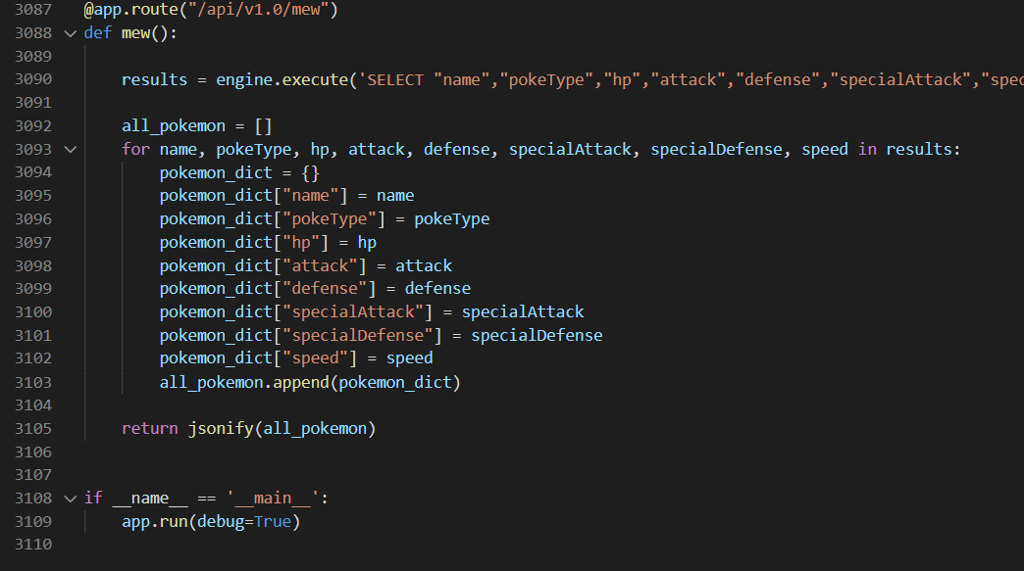
Data Prep: Phase 1
Task: Change Flask Routes
Initial routes: by Type
New routes: by Pokemon
Tools: Python, SQL
3109 lines of code later…

Slide 5
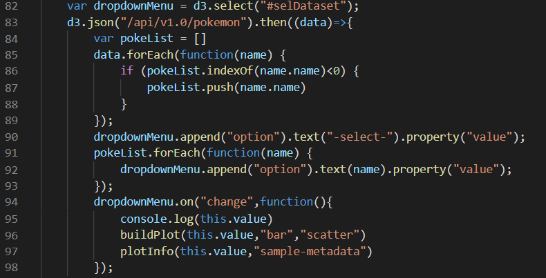
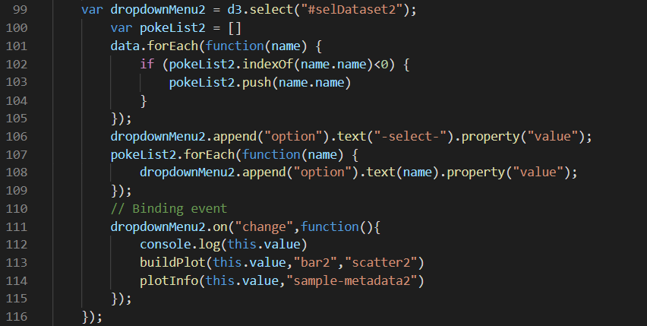
Data Prep: Phase 2
Tasks: Update Dropdown Selection & Add Second Dropdown
Initial selection: by type
New selection: by Pokemon
Tools: HTML & JavaScript

Slide 6
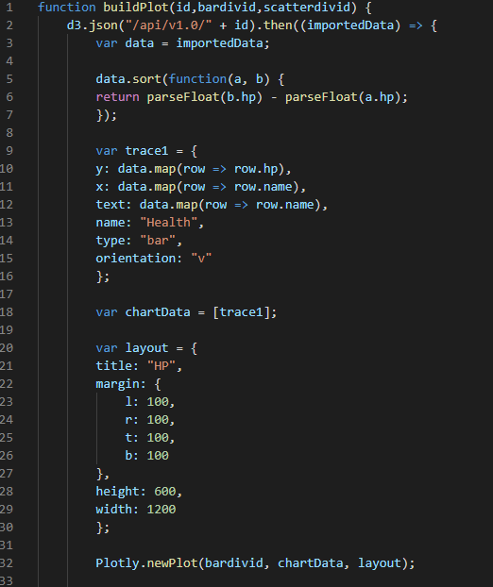
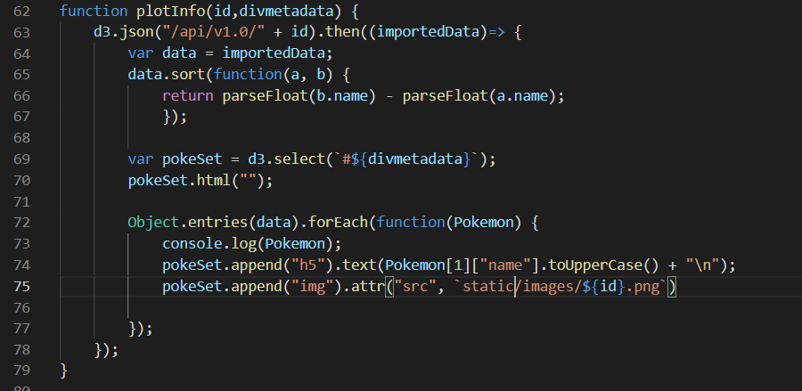
Data Prep: Phase 3
Task: Update Graphs & Add Images
New code includes:
“divids” in buildPlot function
Appending image files in plotInfo function
Tools: HTML & JavaScript
*Shoutout Daniel renaming 151 png files to fit id

Slide 7
Machine Learning PokeBattles: Phase 1
Task: Logistic Regression Planning
Need for each pokemon to have a recorded battle and result
This will feed our Machine Learning in order to predict future battles
No existing dataset on pokemon battles/results
Needed to create our own Battle Engine

Slide 8
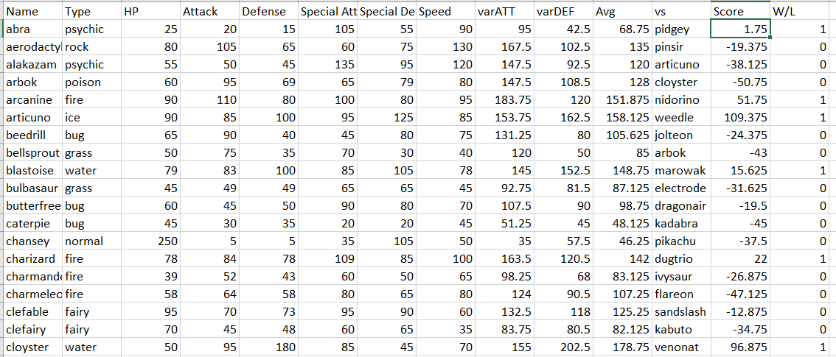
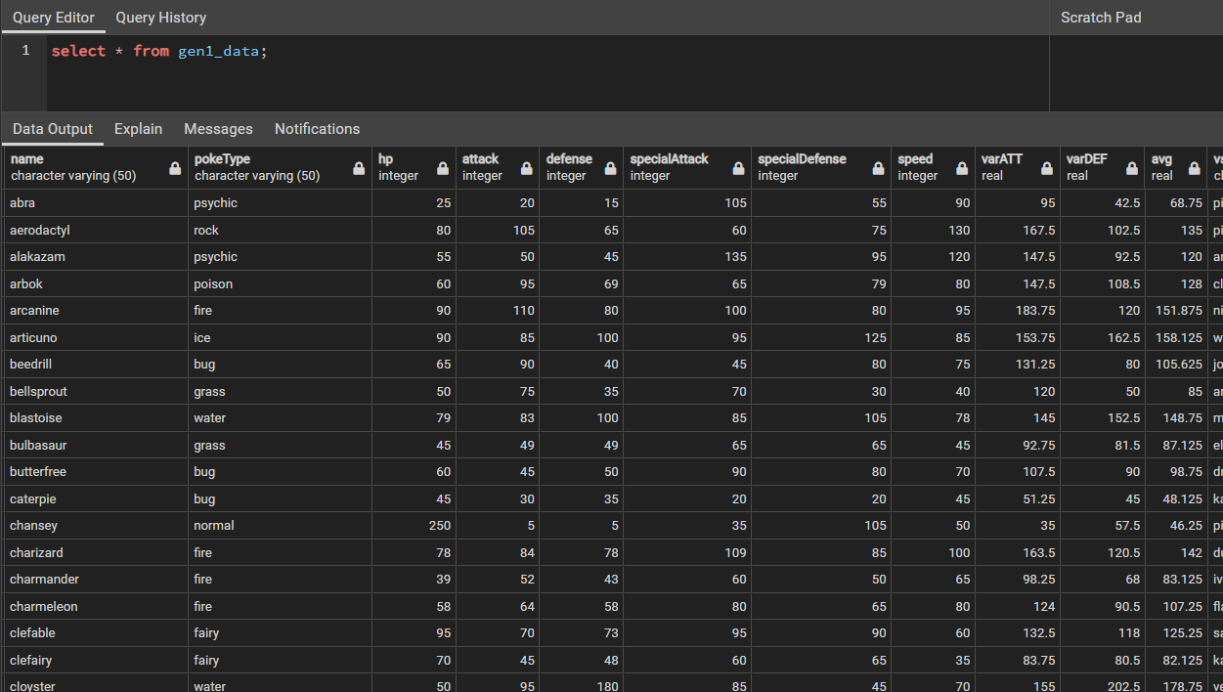
Machine Learning PokeBattles: Phase 2
Task: Create Battle Engine
Initial idea was a complex formula in Python
Running out of time – had to pivot to a more basic algorithm
Created variables for attacking and defending based on stats
Created formula to calculate a score between two pokemon
If score was positive, first listed pokemon (Name) won (1)
Tools: Excel & SQL

Slide 9
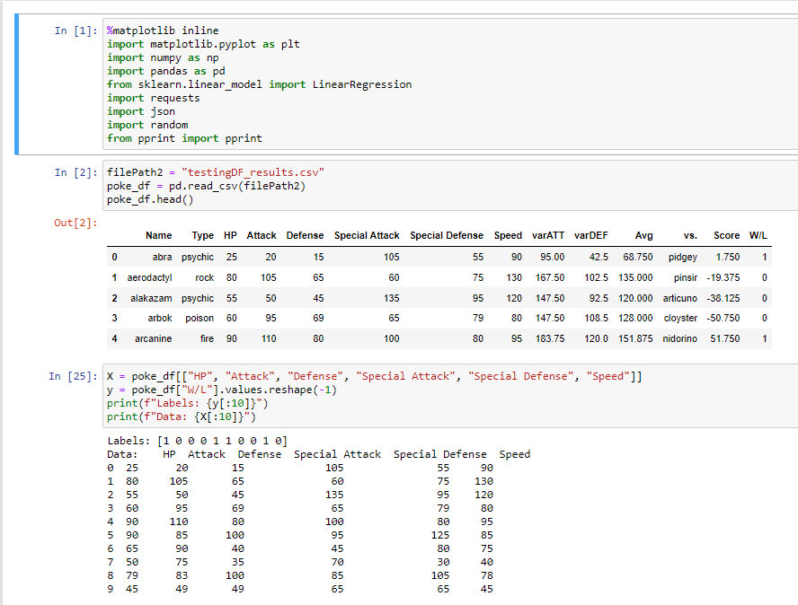
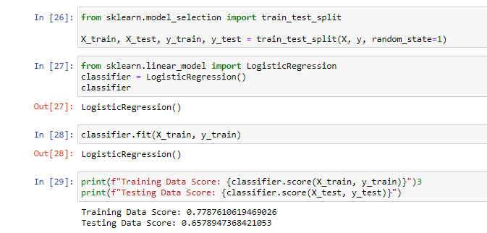
Machine Learning PokeBattles: Phase 3
Task: Create & Test Machine Learning
Logistic regression: predict winner based on stats
Tools: Python & SQL
Imported updated csv & converted to df
Created X & y variables for logistic regression
Used sklearn to run logistic regression

Slide 10
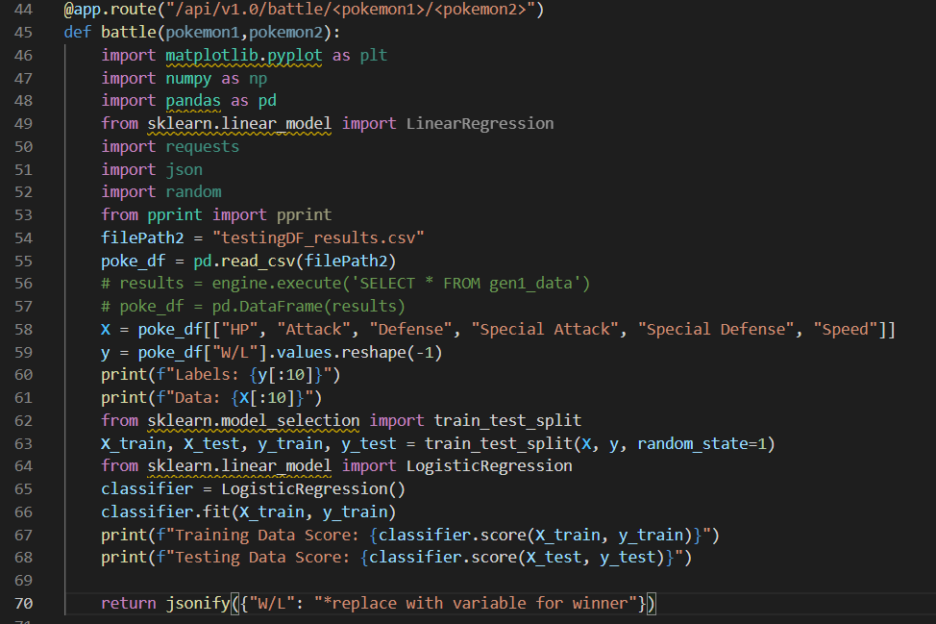
Machine Learning PokeBattles: Phase 4.1
Task: Implement Machine Learning
*Did not complete
Create new Flask route for battles
Insert Machine Learning code
*Needed to create variable for winner
*Needed to return as JSON
Tools: Python, JavaScript, & HTML

Slide 11
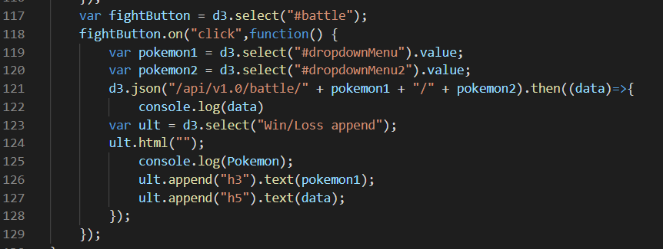
Machine Learning PokeBattles: Phase 4.2
Task: Implement Machine Learning
*Did not complete
Create “Fight” button to call route for winner
Create function to pass selected pokemon
*Needed to return winning pokemon
*Needed to display winning pokemon
Tools: Python, JavaScript, & HTML

Slide 12
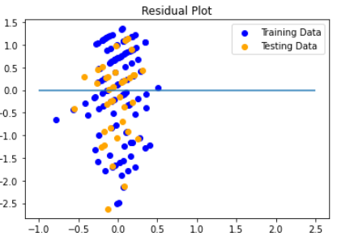
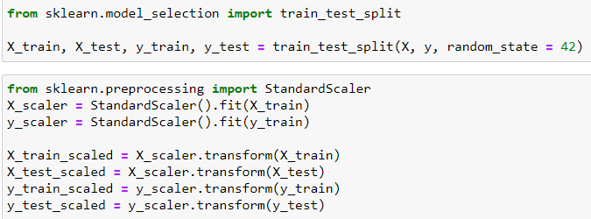
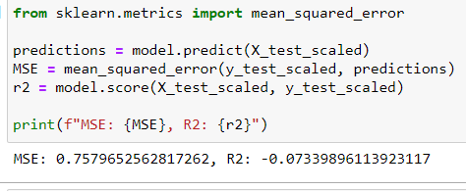
Machine Learning Type Predictions
Task: Implement Machine Learning
Attempt alternative Machine Learning utilization
Use Machine Learning to predict type of Pokemon based on stats
*Types were not defined by stat threshold
Tools: Python

Slide 13
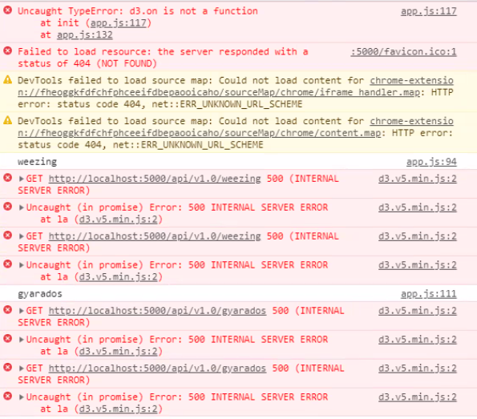

Lost Battles Trials & Tribulations

Slide 14
Lost Battles Trials & Tribulations
Design
Something we

